Slide 1



MIETEN
Get your own home !

Slide 2
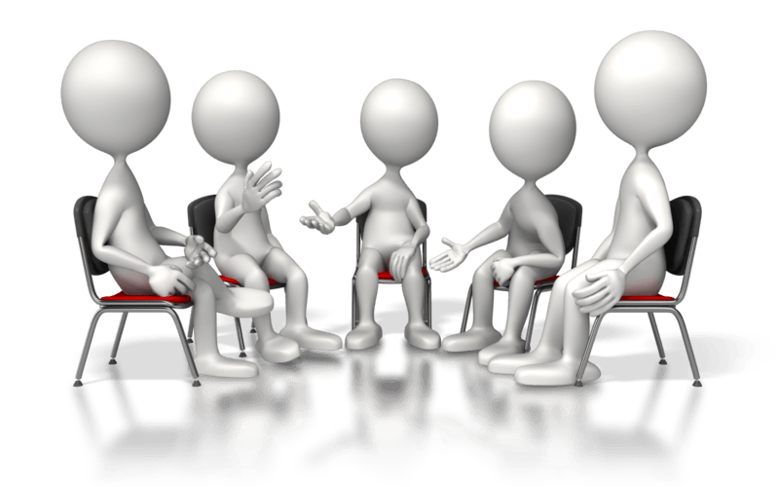
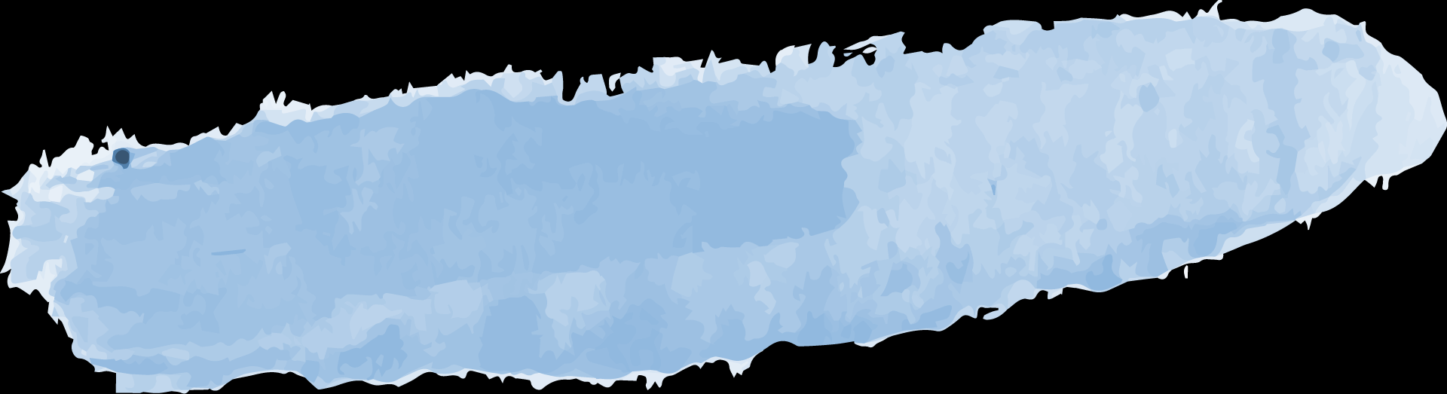
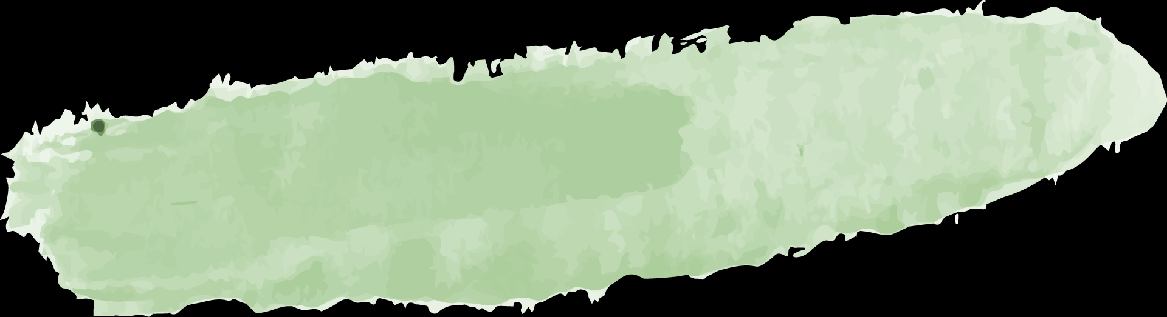
Our Squad
Vinay
Requirement Engineer
Raaghul
Front End Developer
Sujith
Team Lead
Tarun
Tester
Jaganathan
Back End Developer

Slide 3



Table of Contents
Objective
About us
01
02
Services
Our Group
03
04
To show the opportunities for Tenants who are looking to stay outside the Hostel.
SRMIST AI-B
2020-2024
To provide better PG for the student with comfortable rent
Vinay Manikanta
Raaghul
Jagan
Sujith
Tarun

Slide 4
PROBLEM STATEMENT
The current system requires a student to visit the house rental company or landlords in order to rent a PG which is tiresome and waste lot of time
The main objective is to develop an online PG rental management system that allows user to rent a PG without physically contacting them

Slide 5
MODEL CHOSEN
SPIRAL MODEL

Slide 6

SPIRAL MODEL
Spiral model has been chosen for this project in order to achieve the following objectives:
•Allows you to build a software with rapid development of increasingly more complete and compatible version of software according to the needs of customers.
•Allows to secure the data using prototyping.
•Continuous iterations of the framework activities(C,P,M,C,D), which helps in building more sophisticated model.

Slide 7
SPIRAL VS OTHER MODELS
Water Fall model: Does not account for the fact that requirements constantly change. Mieten requirements changes according to the need of customers. No security to data. Risk is high.
V- Shaped model: Does not easily handle dynamic changes in requirements and does not contain risk analysis.
Incremental Model: The above project cannot be done by incremental model, as it can't be delivered by parts. It’s a straight application where users access all the features of the software

Slide 8
SPIRAL VS OTHER MODELS
RAD Model: Customers need changes according to the situation in very less time. In that case, RAD model is not suitable for this project. It also cannot be applied when technical risks are too high.
Prototype Model: Not a cost efficient model. Poor documentation because of continuously changing customer requirements. Too much variation in requirements.
The above factors make SPIRAL model as suitable model for the project .

Slide 9

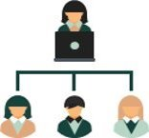

How are we considered Profitable?
Owners
Server
Tenants
Can notice the Rooms near any place in just a click.
They can approach wide no of Tenants with this interface
Maintain the relation between owner and Tenants

Slide 10
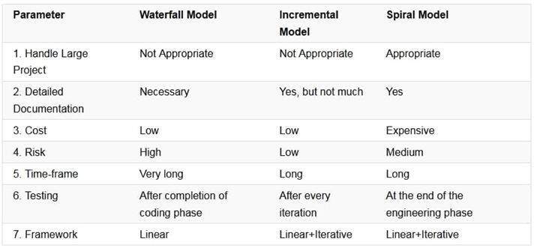
SPIRAL VS OTHERS​

Slide 11


Slide 12
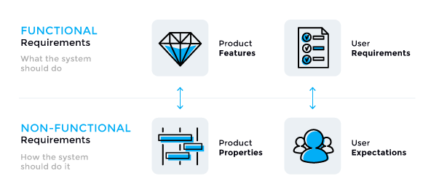
TYPES OF REQUIREMENTS

Slide 13
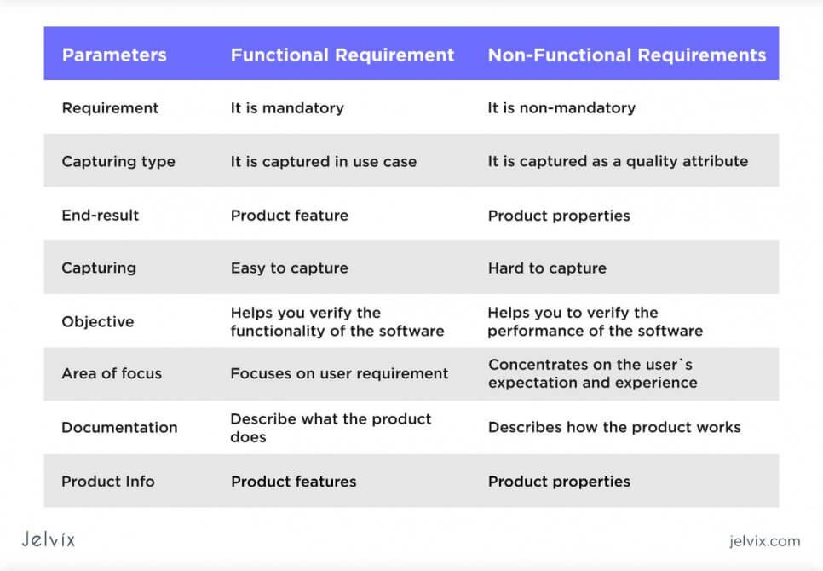
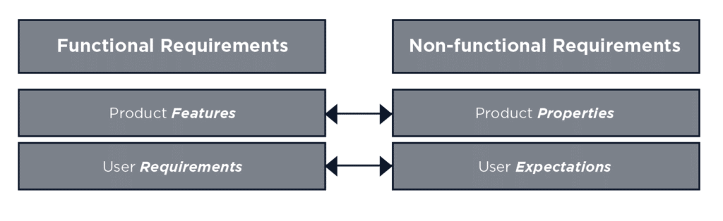
Difference between Functional and Non Functional

Slide 14
FUNCTIONAL REQUIREMENTS
Functional requirements define the basic system behaviour. Essentially, they are what the system does or does not do, and is a representation of how the system responds to inputs.
Functional requirements usually define if/then behaviours and include calculations, data input, and business processes.
Functional requirements are features that allow the system to function as it was intended to. features and focus on user requirements.
If the functional requirements are not met, the system will not work. Functional requirements are product

Slide 15
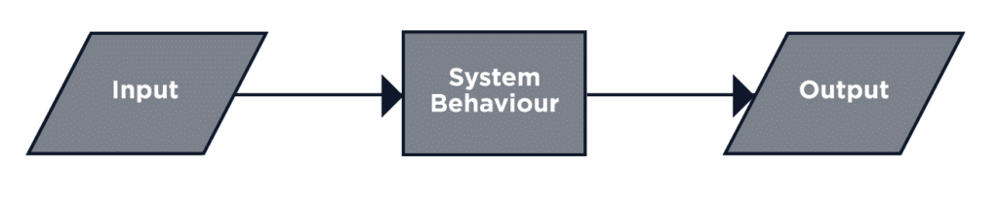
Simple Diagram for Functional Requirements

Slide 16
FEATURES INSTALLED IN MIETEN
Registration: If the user is not registered, then first the user must be registered using appropriate credentials.
Login: If the user is registered then he/she will be logged in by entering appropriate credentials. The user must be able to view the Rooms near a certain place.
Location: User observe the place that should be near and convenient to him . User checks that the availability of emergency sources(medical shop ,hospital , groceries).
Rooms: User can get different types of options in which they can choose the type of room .In that there can be like 1BHK,2BHK,3BHK,1sharing,2sharing,3sharing,with AC , without AC.

Slide 17
FEATURES INSTALLED IN MIETEN
5.Gender : In this user can get the option to select their gender.​
6.Budget : User get the chance to select the room or flat in their budget.​​
7.Food:User get the chance to choose the room with including meals ​
or without including meals.​
8.Life style: User can get the chance of choosing the room that is furnished or not.
9.Submit Ratings: The User must be able to rate according to his/her experience.
10.And should provide the feedback in detail.
11.Logout: The user must log out from the system when he wants to. ​
​ ​

Slide 18
Non – Functional
If a system will still perform without meeting the non-functional requirements, why are they important? The answer is usability. Non-functional requirements define system behaviour, features, and general characteristics that affect the user experience. How well non-functional requirements are defined and executed determines how easy the system is to use, and is used to judge system performance. Non-functional requirements are product properties and focus on user expectations.
There are more examples below, but for now, think about a functional requirement that the system loads a webpage after someone clicks on a button. There should be a related non-functional requirement specifying how fast the webpage must load. Without it, the user experience and perception of quality are at risk if they are forced to wait too long, even though the functional requirement is fully met.

Slide 19
Security: The system needs to log client’s information of registration such as IP address and time for security purpose. Password: should encrypt and store in the database.
Maintainability: The system developing using Struts, all action is detailed in struts-config.xml and web.xml that easy to modify and make update. Portability: The web application is coding in J2EE and Struts, therefore, it should be transferable between different OS and Java container
Usability: The system shall allow the users to access the system from the Internet using HTML or its derivative technologies. The system uses a web browser as an interface. Since all users are familiar with the general usage of browsers, no specific training is required. The system is user friendly and self-explanatory.
Reliability: The system has to be very reliable due to the importance of data and the damages incorrect or incomplete data can do.

Slide 20
System Requirements
System requirements is a statement that identifies the functionality that is needed by a system in order to satisfy the customer’s requirements.
System requirements are a broad and also narrow subject that could be implemented many times. Also, taking it down to the exact hardware or coding that runs the software.
Examples of system requirements could be: the size of memory needed to install a software on your computer, the miles per gallon a car needs to get, or the printing speed of a printer.

Slide 21
System Requirements contd..
System requirements could cause a company to save a lot of money and time, and also can cause a company to waste money and time. They are the first and foremost important part of any project, because if the system requirements are not fulfilled, then the project is not complete.

Slide 22
Hardware Requirements
A processor of Pentium 4 ,1.2GHz or faster
4GB of RAM (8GB of RAM recommended)
A high-speed Internet connection(1.5 Mbps upload and download required; 5 Mbps or better preferred)
Caution: The use of public access computers or employer-provided computers may result in slowness or errors when accessing course materials. Public access computers may not permit access to certain course materials or systems due to security limitations.

Slide 23
2. Software Requirements
Operating System
Microsoft Windows 7 or newer
Apple macOS 10.14 or newer
Web browser
Google Chrome, the latest version, is recommended
Antivirus software, updated regularly, is strongly recommended

Slide 24
USE CASE
DIAGRAM

Slide 25
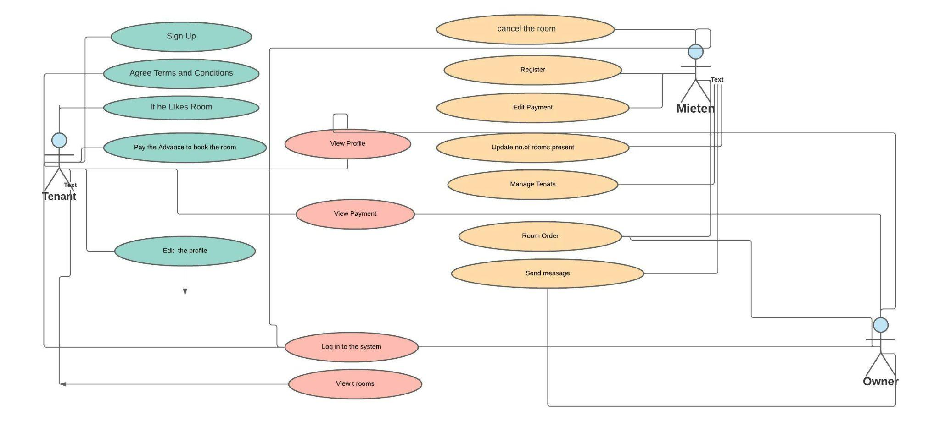

Slide 26
USE CASE DIAGRAM DESCRIPTION
Feature- Manage user profile
Purpose-To enable user to manage the user profile
Precondition- The user must login into the system
Main Flow -
1. The user click on the account information tab in the menu.
2. The system will show the user about the user information.
3. User click on the change password button to change password.
4. User can change any field except the username which is not editable.
5. User click on update button to update the user account.
6. System verifies the all the input of the user information.
7. System will update the user account.
8. System will display the message to inform user that the user account has been successfully updated

Slide 27
Feature- User can view the availability of rooms
Purpose- To enable user to view the rooms for the consultation of owner.
Precondition- User must login into the system.
Main Flow -
1. User click on the rooms menu in which he is interested.
2. The system will show the user about the detail rooms availability.

Slide 28
ACTIVITY DIAGRAM

Slide 29
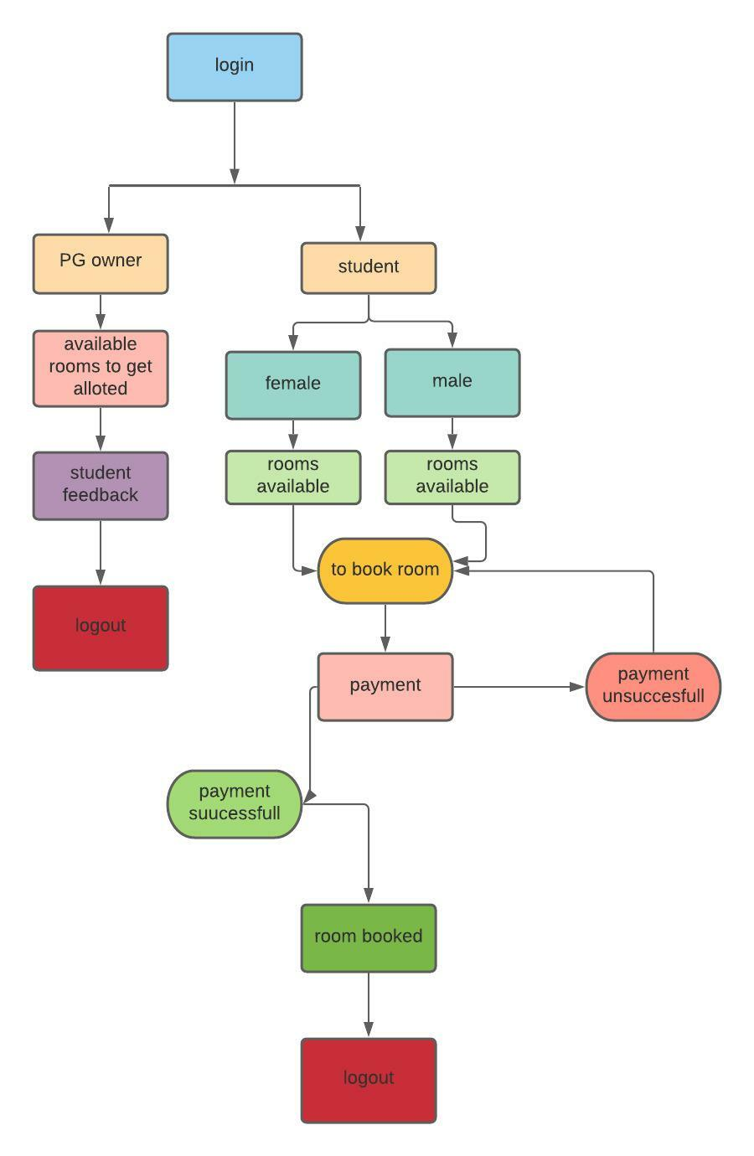

Slide 30
SEQUENCE DIAGRAM

Slide 31
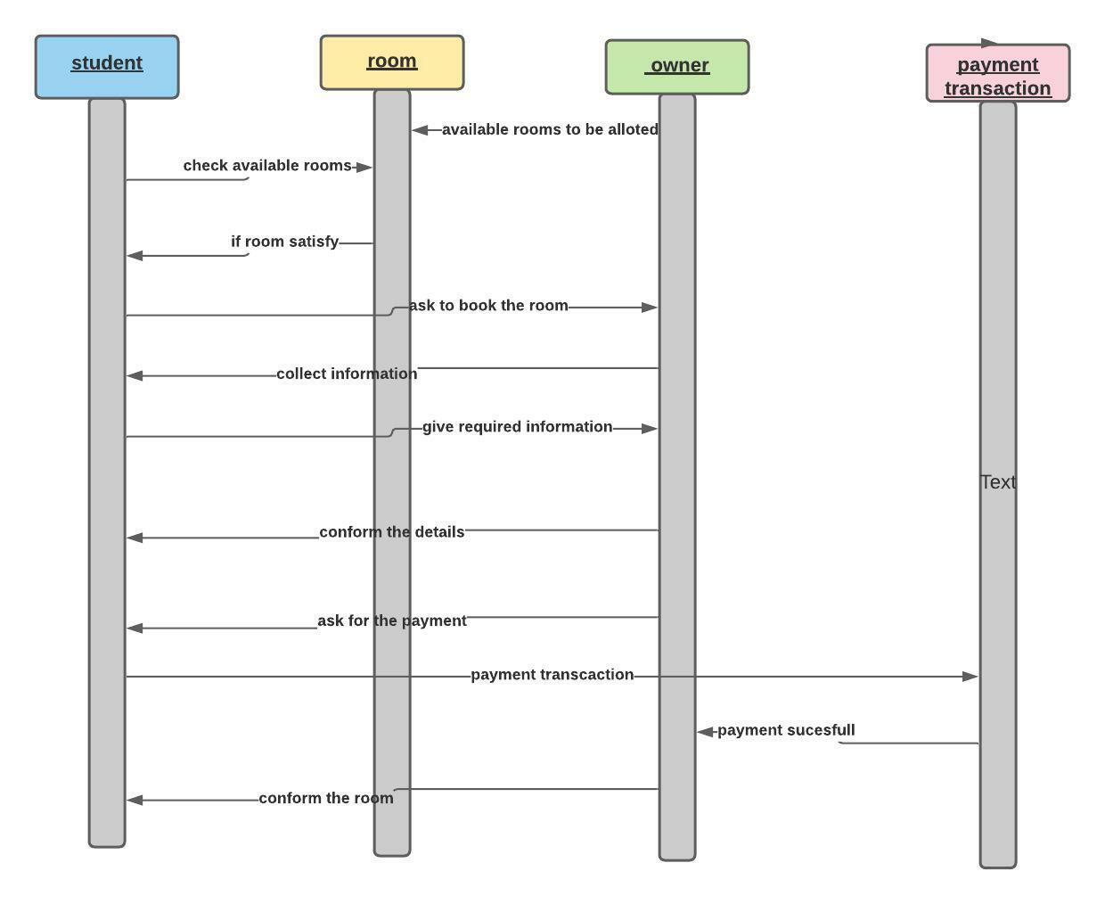

Slide 32
COMPONENTS
MySQL-
MySQL will be used to develop this project. MYSQL is an open source relational database management system that uses to manipulate the database.
Apache Web server Apache is one of the web servers to run for this project.
Node.js-
Node.js is implemented to develop this project. This project will be using node as another server. Node server will be building the some feature for this project such as the webRTC, screen sharing, and file sharing feature.
Hypertext Markup Language (HTML)-
HTML will be the markup language to create this project website. HTML is use to organize and display the content of the webpage.

Slide 33
Cascading Style Sheet (CSS)-
CSS is the style sheet language that will be used to along with HTML in this project to provide better view.
JavaScript
JavaScript is the client side language that will be used to develop this project. Some processes do not need to go through the server and can be handling by JavaScript such as simple validation or button event by writing function.
Hypertext Preprocessor (PHP)- PHP will be selected as server side language for developed this project. The reason PHP is selected because PHP can work together with MySQL and can run on apache web server. PHP is use to process the request from the client side reply the result to the client side.

Slide 34
OZEKI NG SMS Gateway
OZEKI Ng SMS gateway is used as a SMS gateway because it free for trial. OZEKI also help to automatically sent the schedule SMS from the database. Furthermore Ozeki Ng SMS gateway also can connect with MYSQL database with the help of the ODBC drivers.
RTCMulticonnection WebRTC library
RtcMulticonnection API is used because it is open source. It offered API that easy to learn and used. Furthermore, it also able to support and build the screen sharing

Slide 35





OUR FORCE
Vinay
Raaghul
Jagan
Sujith
Tarun

Slide 36
THANK YOU

